Slide 1

PORTFOLIO FOR RESEARCHERS
STUDENT NAME : Divyadharshini N
REGISTER NUMBER : 2422K2513
NMID : 3DC0E15B0D569A9AF34D68069D941D5
DEPARTMENT : BSC CS
COLLEGE :Dr.Rv.Arts and science college/Bharathiyar university

Slide 2
Project title
PORTFOLIO FOR RESEARCHERS

Slide 3
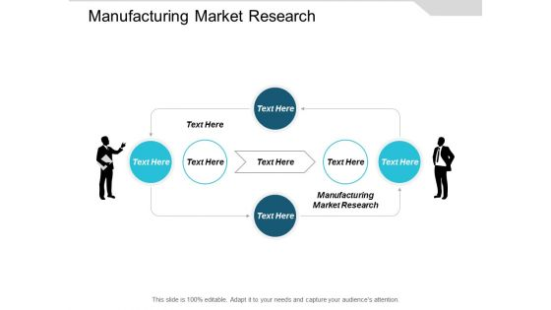
AGENDA
Portfolio statement
Project overview
Ends Users
Tools and technologies
Portfolio design and layout
Features and functionality
Result and screenshot
Conclusion
Github link

Slide 4
Problem statement
Context: Briefly describe the industry, the product, and the project goals to provide background. The Problem: Clearly define the issue or the challenge the research addresses. Root Cause: Explain why the problem occurred or what factors led to it. Affected Stakeholders: Identify who is impacted by the problem, including users and internal teams.

Slide 5
Project overview
Project Background & Context:Explain the initial situation, identify knowledge gaps, and state the desired decisions or goals for the project. Researcher’s Role:Describe your specific responsibilities and how you collaborated within the team. Research Questions & Plan:List the questions you aimed to answer and explain your chosen research methods and timeline.
Participants & Recruitment:Detail how you identified and recruited participants for your study.

Slide 6
END USERS
Context & Problem: Explain the challenge, project background, and the initial knowledge gaps that led to the research. Your Role: Clearly state your specific contributions and responsibilities within the project team. Research Questions: Detail the questions you aimed to answer and how you developed them. Research Plan & Methods: Describe the research techniques you chose (qualitative, quantitative, etc.) and why, including recruitment criteria.

Slide 7
Tools and technologies
Define your audience:Research potential employers and the skills they value to tailor your portfolio.
Select impactful projects:Choose projects that demonstrate your ability to solve complex problems and the methodologies you used.
Showcase your research process:For each project, detail the problem, your research questions, the plan, methodology, and how you conducted the research.

Slide 8
Portfolio design and layout
Visual Consistency:Use a limited, complementary color palette and a few easy-to-read fonts to create a cohesive and professional look that doesn’t overshadow your work. User-Friendly Navigation:Organize your portfolio with clear sections and categories (like different research types or user groups) to make it easy for visitors to find specific projects and information. Responsive Design:Ensure your portfolio looks and functions well on various devices, including desktops and mobile phones, so it can be easily viewed by anyone.

Slide 9
Features and functionality
Introduction: A brief overview of yourself and your professional background. Case Studies: Detailed narratives of 2-4 key research projects. Project Context: Clearly define the challenge or problem the research aimed to solve. Research Questions: State the specific questions you sought to answer through your research. Research Process: Explain your chosen methodology, the research plan, and the timeline. Participant Recruitment: Describe the criteria for selecting participants and the recruitment process.

Slide 10
Result and screenshot
Context: Clearly state the project’s goals, duration, and the users you studied. Narrative: Tell an engaging story about why the research was needed and what it accomplished. Your Role: Define your specific contributions and responsibilities. Teamwork: Describe the cross-functional team you collaborated with (e.g., designers, developers). Process & Outcomes: Detail your research methods, the evidence gathered, and the concrete impact of your work. Deliverables: Showcase the tangible outputs of your research, such as reports or presentations.

Slide 11
COnclusion
Summarize Key Insights:Briefly reiterate the main points and significant learnings from your portfolio’s content. Highlight Growth and Reflection:Reflect on the skills developed and personal or professional growth that occurred during the research process. Emphasize Impact:Reinforce the importance and relevance of your research findings or projects. State the Narrative’s End:Conclude the story of your research effort, explaining what was accomplished and its significance. Reiterate Project Goals and Findings:Connect back to the initial goals of your research and the key outcomes or conclusions you reached.

Slide 12
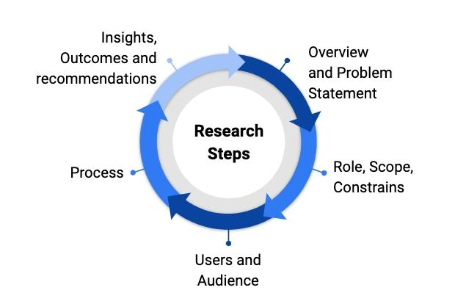
GitHub link
https://github.com/academicpages/academicpages.github.io Description: This is one of the most widely used and well-maintained academic portfolio templates on GitHub. It uses Jekyll and Markdown to automatically generate a website that can host your publications, research projects, talks, and teaching experience. Key features: Easy to set up, even for researchers with minimal coding experience. Hosts your site directly from a GitHub repository using GitHub Pages. Includes automated scripts for populating publications via BibTeX files.

Slide 13
Thanking you buddy’s

